Slide 1
Implementation of ZSM Closed Loop
TFS TECH Meeting
Panagiotis Famelis (Ubitech)

Slide 2
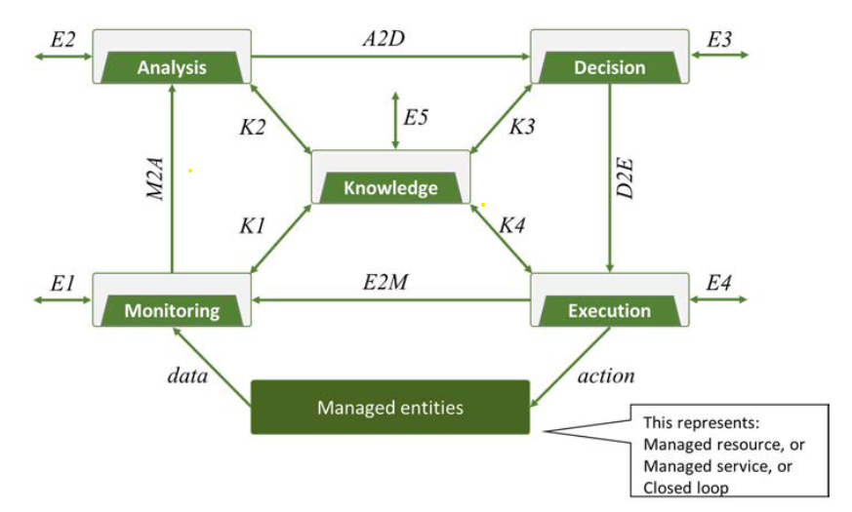
ZSM closed loop
Insights
Information
Workflows
Data
Actions
According to
ETSI GS ZSM 009-1

Slide 3
Mapping to TFS (Initial Idea)
Analytics
Automation
+
Policy
DB
Monitoring
Service/SBI
New Component
Existing Component

Slide 4
Mapping to TFS (New Idea)
Automation
Analytics
Policy
DB
Automation acts as a Frontend of the ZSM Loop.
Thus, it is “outside” of the ZSM Loop.
Or maybe “over” the ZSM loop
Monitoring
Service
/SBI
New Component
Existing Component

Slide 5
Mapping to TFS (New Idea)
Automation
Set Analysis
Set Policy
Analytics
Policy
DB
Based on the input, it creates the necessary KPIs, Analyses and Policies.
The first version can simply work as an organizer.
Set KPI
Monitoring
Service
/SBI
New Component
Existing Component

Slide 6
Alarm loops
Automation
Two distinct loops should be eventually implemented.
ZSM Loop which acts according to ETSI ZSM.
Automation Loop which may alter the ZSM parameters, spawn another ZSM Loop, etc.
Alarms
Set (new) Policy
Set (new) Analysis
Alarms
Policy
Analytics
Set (new) KPI
Monitoring
Service
/SBI

Slide 7
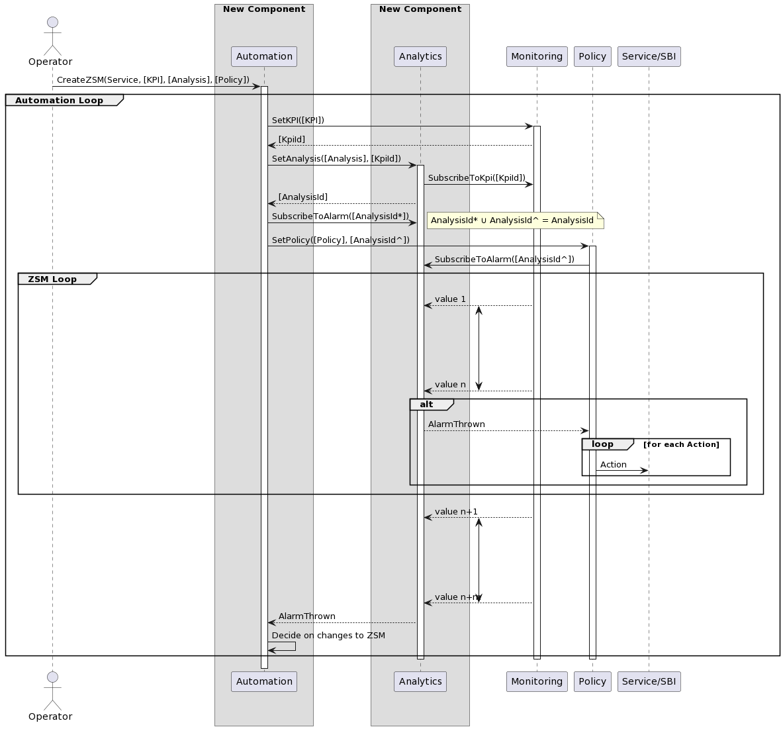
Automation can subscribe to different Analysis from Policy.
The specific communication between Monitoring, Analytics and Policy should be re-examined.
  Currently Policy Creation implies Alarm Creation too.
Notes:
@startuml
skinparam responseMessageBelowArrow true
!pragma teoz true
actor Operator
box New Component
participant Automation
end box
box New Component
participant Analytics
end box
Operator -> Automation : CreateZSM(Service, [KPI], [Analysis], [Policy])
activate Automation
group Automation Loop
Automation -> Monitoring : SetKPI([KPI])
activate Monitoring
Monitoring --> Automation : [KpiId]
Automation -> Analytics : SetAnalysis([Analysis], [KpiId])
activate Analytics
Analytics -> Monitoring : SubscribeToKpi([KpiId])
Analytics --> Automation : [AnalysisId]
Automation -> Analytics : SubscribeToAlarm([AnalysisId*])
note right
AnalysisId* ∪ AnalysisId^ = AnalysisId
end note
Automation -> Policy : SetPolicy([Policy], [AnalysisId^])
activate Policy
Policy -> Analytics : SubscribeToAlarm([AnalysisId^])
group ZSM Loop
{start1} Monitoring --> Analytics : value 1
|||
|||
|||
|||
{end1} Monitoring --> Analytics : value n
{start1} <-> {end1}
alt
Analytics --> Policy : AlarmThrown
loop for each Action
Policy -> "Service/SBI" : Action
end
end
end
{start2} Monitoring --> Analytics : value n+1
|||
|||
|||
|||
{end2} Monitoring --> Analytics : value n+m
{start2} <-> {end2}
Analytics --> Automation : AlarmThrown
Automation -> Automation : Decide on changes to ZSM
deactivate Monitoring
deactivate Analytics
deactivate Policy
end
deactivate Automation
@enduml

Slide 8
PROJECT CONSORTIUM

